Slide 1

M&A Tickets
MCB 638
Sana Khan

Slide 2

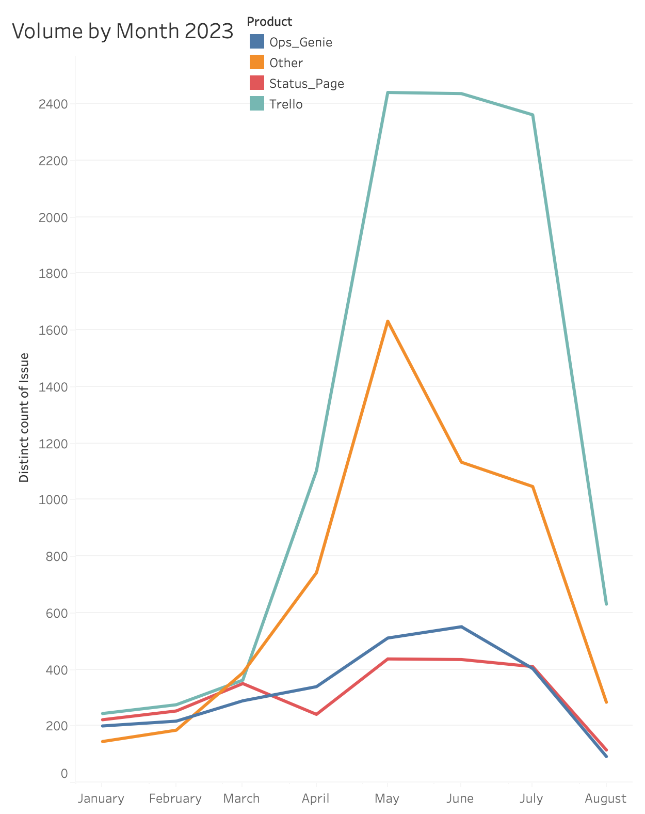
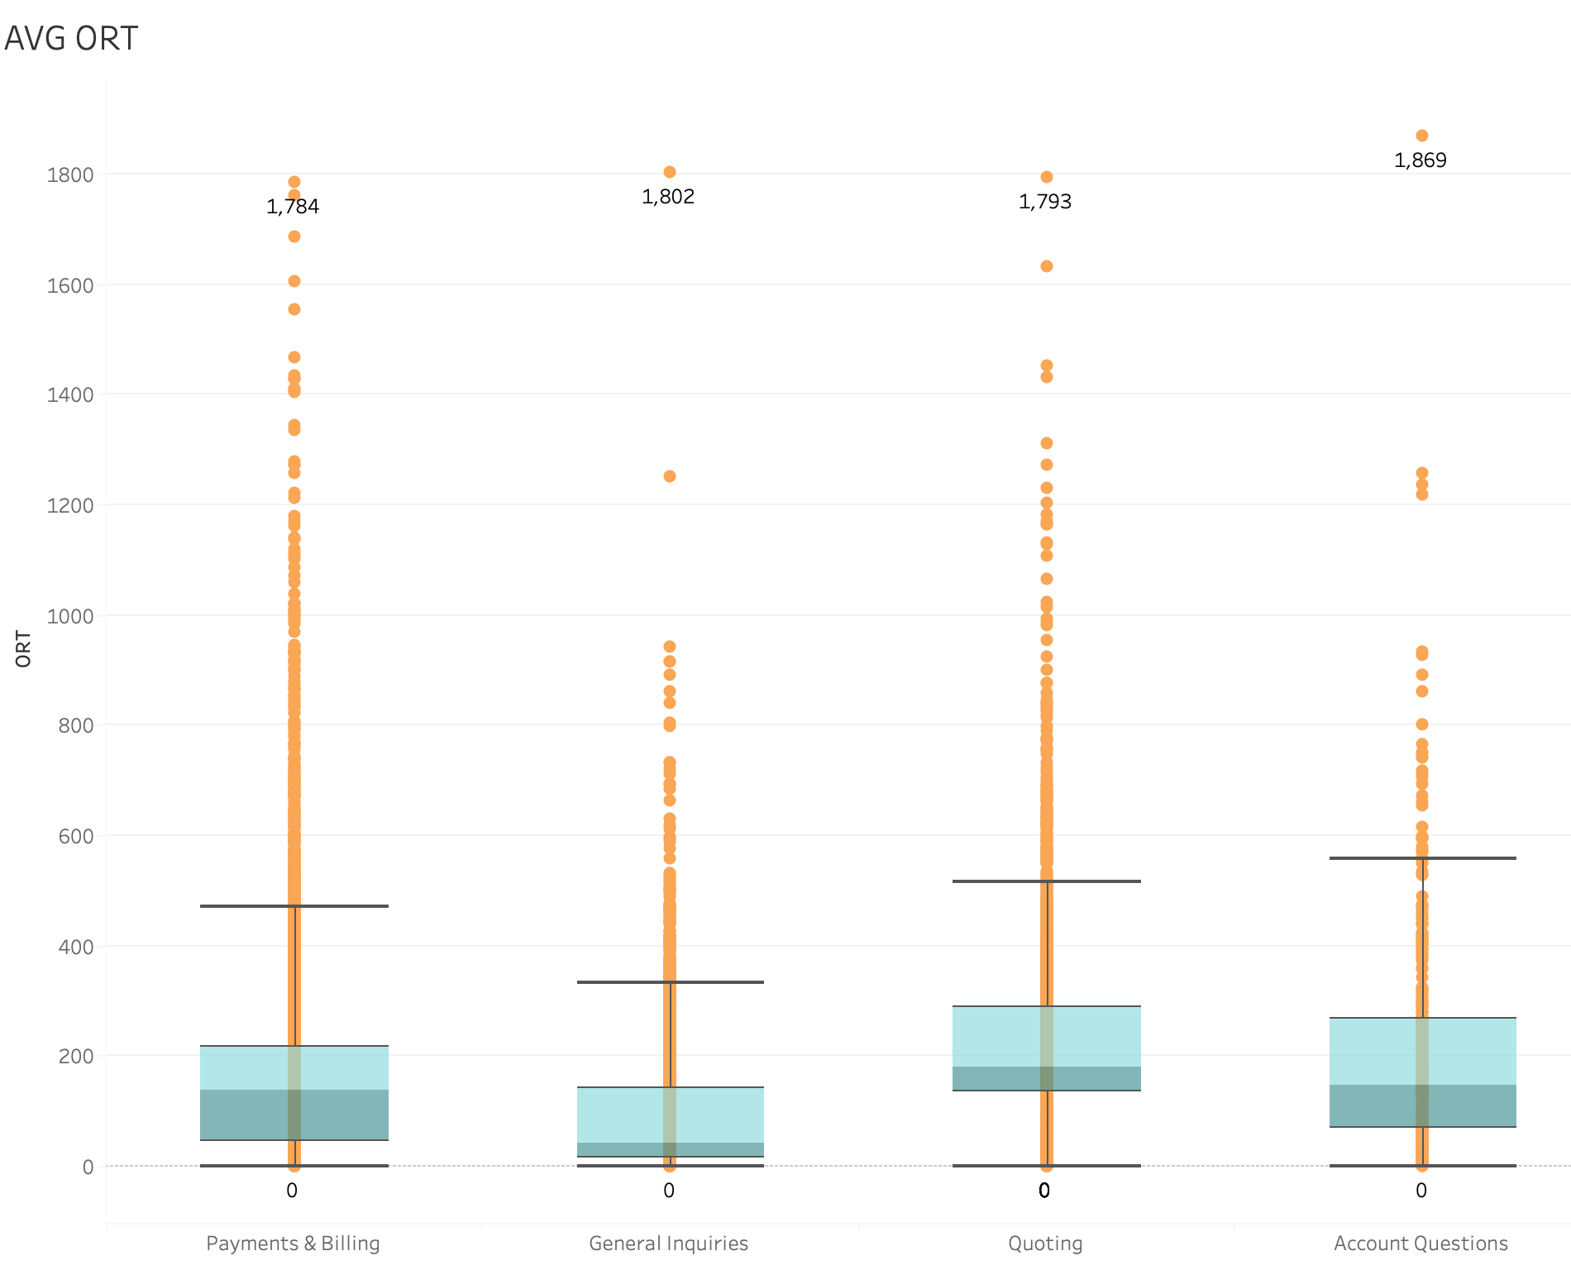
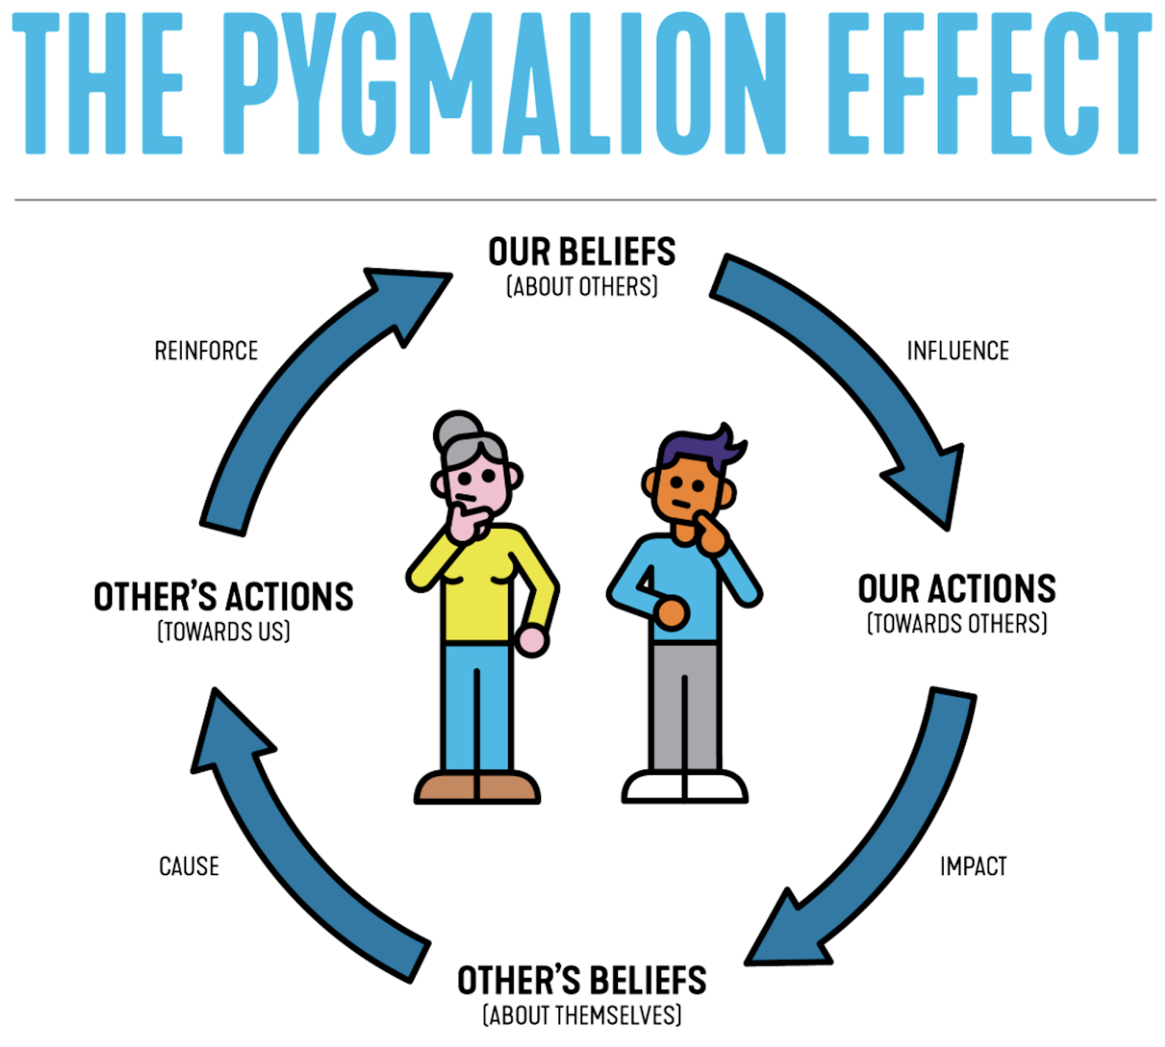
M&A Ticket Analysis
Sana Khan
Key Dates --->
Define
June
Measure
July
Analyze
August
Improve
2024
Control
September
DEFINE
MEASURE
ANALYZE
IMPROVE
Problem Statement
If we focus on ORT, the tickets that have the highest range for ORT are
Account Questions
General Inquiries
Quoting
Payments & Billing
Use Intelligent automation to reduce the highest volume topics and tickets
Collect more information from customers on the form for when they are trying to purchase
Allow self service for topics with the highest ORT if possible
The Mergers & Acquisition team is carrying a daily backlog of more than 500 tickets. This is causing the team to be stressed out and feeling burnt out
There’s been an increase in ticket volume and the Overall resolution time for M&A tickets is higher than other tickets
CONTROL
Business Impact
The business impact of not fixing this issue is to either hire more CA’s, which cost about 50K USD per member, or loose customers, which would impact revenue.
AVG ORT M&A = 138 hours
AVG ORT non-M&A = 96 hours
SQL = 1.5
Many areas for improvement
Quoting has the 2nd highest ORT at 233 hours – that’s a long time to purchase!

Slide 3
Data definition
Customer Advocate Team – CA Team
Mergers and Acquisition Team – M&A
Overall Resolution Time – ORT measured in hours as the time it takes to close the ticket
Customer Satisfaction – CSAT
AMER, APAC, EMEA – Geo’s (The three Geo’s the team spans)

Slide 4
Define
The problem we are trying to solve is to remove the backlog of tickets the M&A team has. The team is facing burnout and potential lower CSAT scores due to how long the tickets stay open.
Success is clearing the backlog by either decreasing the ORT or reducing the volume of tickets
Output is ORT/ Volume
Input is product, geo, assignee, topic of the ticket
The current process is that a customer opens a ticket, which goes to the M&A queue. CA’s will take up to 15 new tickets per day and work old tickets if a customer has responded. The CA will assist the customer with purchasing, paying for products and basic troubleshooting for product/account questions

Slide 5
Define SQL
Defect is any ticket above 100 hours
1. Defect opportunities per unit: D = 1
2. Units produced per timeframe: U = 20477
3. Total possible defects per timeframe: D × U = 20477
4. Total actual defects during that timeframe: A = 10563
5. Defect per opportunity rate: A ÷ DU = DPO =.5158
6. Defects per million opportunities (DPMO): DPO × 1,000,000 = 515,800
7. SQL value 1.5
A SQL of 1.5 shows that we have a lot of room to improve our process

Slide 6
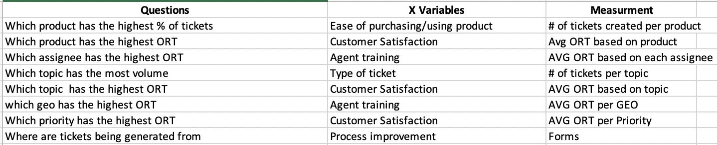
Measure Data Stratification Tree
Data was collected from tickets in support system (GSAC) and stored in data warehouse (Socrates). This data is existing data that is collected by pipelines created by Data Engineering daily
Timeframe of data collection is January 1st 2023 – August 1st 2023
The data was collected during this timeframe because the M&A team was formed in January and has been carrying a daily backlog since May
ORT is measured in hours, which is continuous data
20476 Total Tickets created over the time frame
Total Volume is 48% Trello Tickets, 27% Other, 13% Ops Genie, 12% StatusPage
Other is comprised of Trello, Ops Genie and StatusPage tickets but it is not possible to define which cohort it belongs to

Slide 7
Measure Confidence interval
The average ORT for M&A tickets is 137.5 hours, with a standard deviation of 158 hours
The minimum sample size required to detect a 20 hour change in the population mean with 95% confidence is 241 tickets. If we collect less tickets we will have a lower confidence or will have to increase our interval
The Upper Limit for the Confidence interval is 139.67 hours, and the lower limit is 135.3 hours
Measurement error can be found in the timestamp of the resolution date. If a CA forgets to use the resolved status, the ORT could be falsely inflated
To minimize measurement error, we should have the timestamp automatically added when the data is ingested into Socrates. We can do this by setting the ticket to auto closure if there has not been a response in 5 business days from the customer and using the date the last response the CA sent as the solution date
2
N =
z* x sample std. dev
E
Z* = 1.965
St Dev = 158
E = 20
N = 241

Slide 8
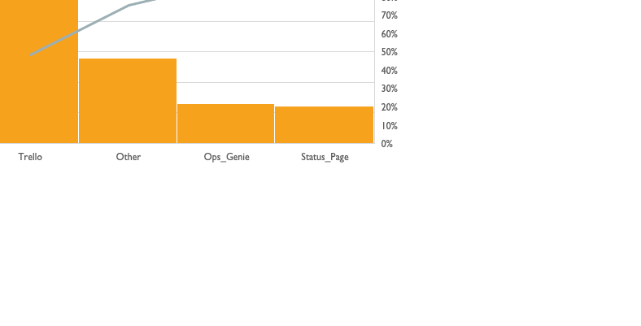
Analyze Pareto Chart
Data was pulled from 1/1/23 – 8/1/23
48% Trello Tickets
27% Other
13% Ops Genie
12% StatusPage
Trello makes up almost 50% of the tickets
Ticket volume

Slide 9
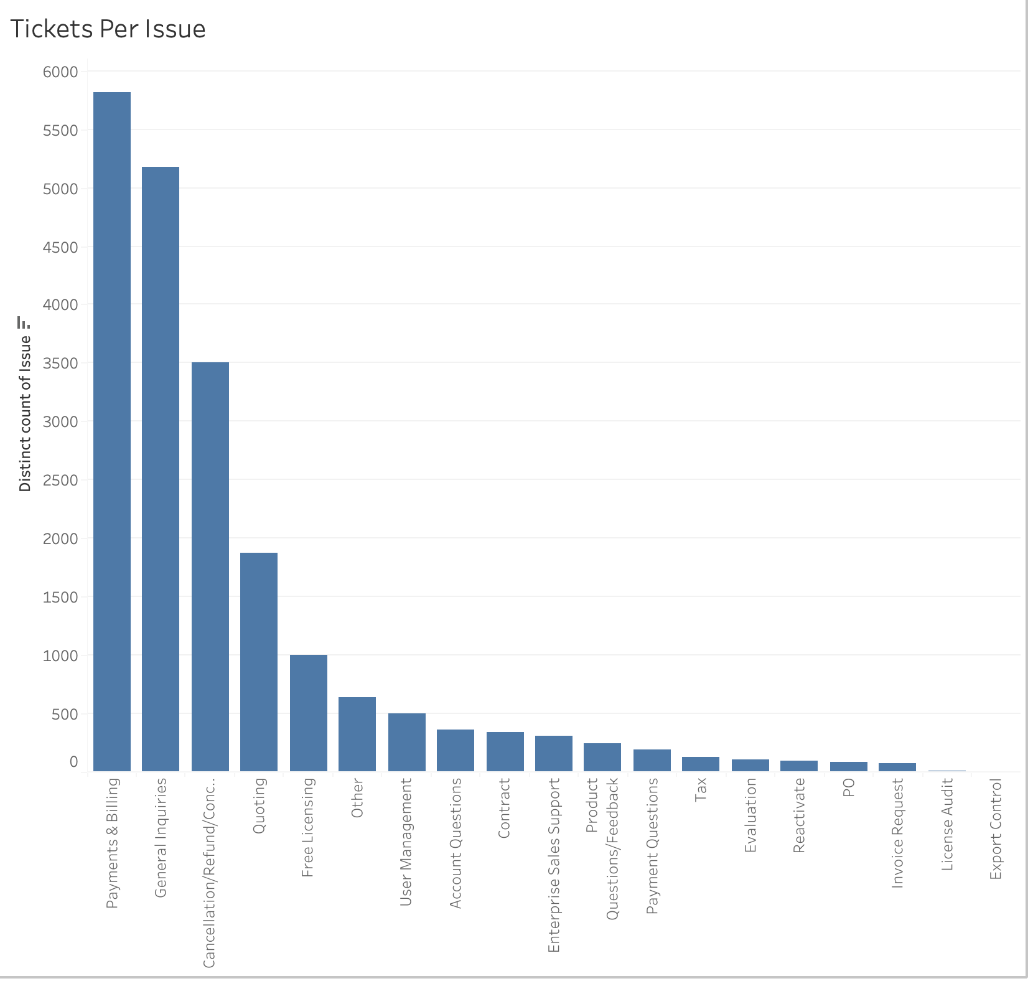
Analyze Bar Chart
The topics with the most tickets are Payments & Billing, General Inquiries and Cancellations, which make up 70% of the total volume of tickets
To lower this volume, we could provide customers with the ability to self service cancellations or adding payment methods

Slide 10
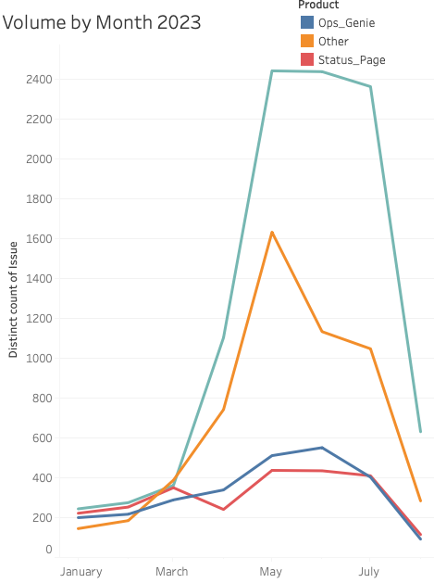
Analyze Timeplot
We can see a spike that shows Trello tickets have more than doubled from March – July while other products tickets have not seen such a large spike
The highest spike for Trello seems to be in May, while other products had more consistency in volume
We will need to investigate to understand what is causing the spike in volume – was there a change in the product that caused this?

Slide 11
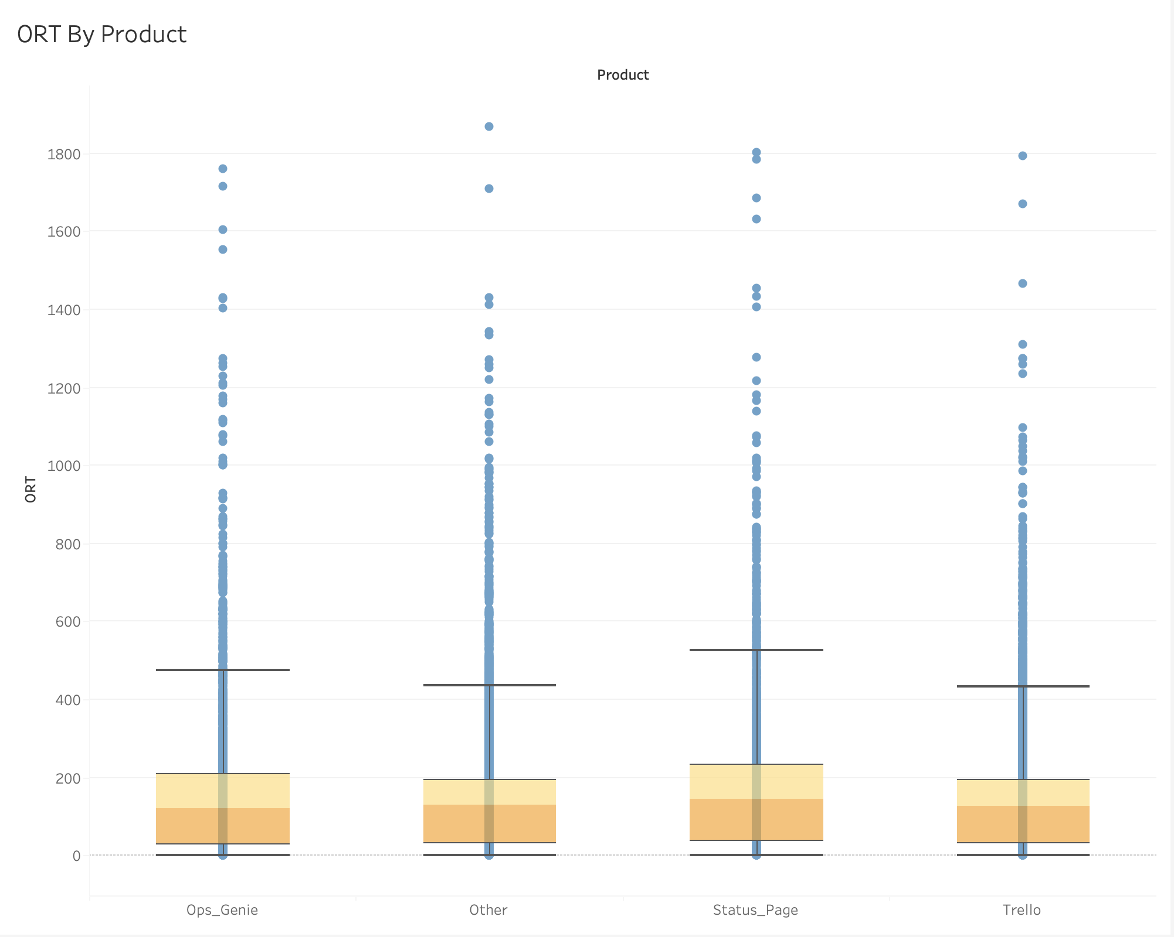
Analyze Boxplot ORT by product
The boxplot shows that among all products there is a wide range for ORT
StatusPage has the highest average ORT at 175 hours
Ops Genie has an average ORT of 155 hours
Other has an average ORT of 138 hours
Trello has the lowest with an ORT of 120 hours
We need to look into what is causing StatusPage to have such a high ORT

Slide 12
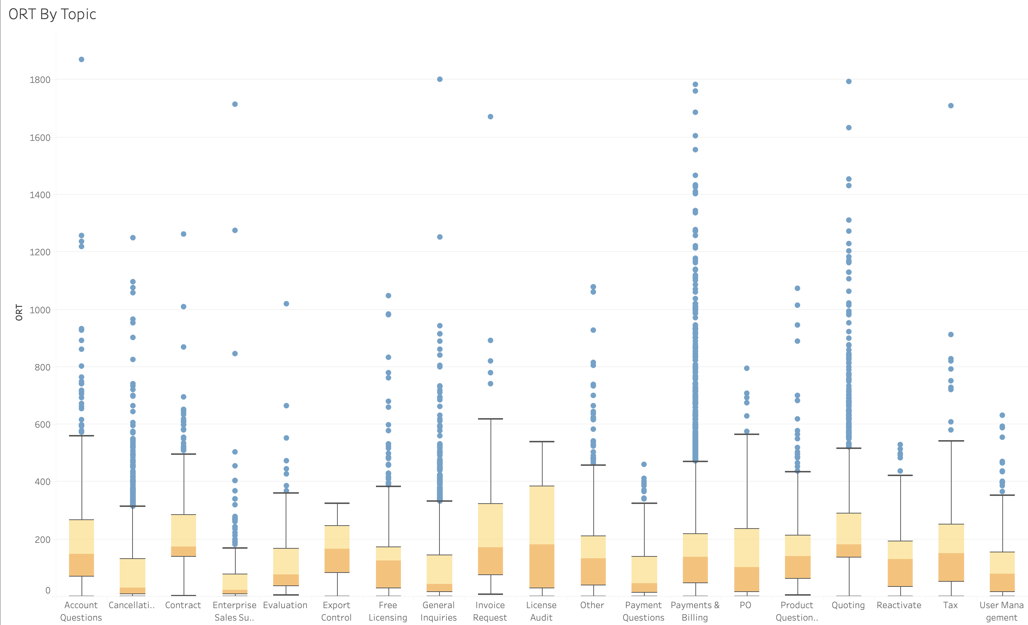
Analyze Boxplot ORT by Topic
This boxplot shows the ORT by ticket topic
The top 5 topics with the widest range are Account Questions, General Inquiries, Quoting, Payments & Billing and Enterprise Sales Support
Based on this chart, we should start to look into how to lower ORT for topics around purchasing, paying for our products and using our products to increase CSAT and retention

Slide 13
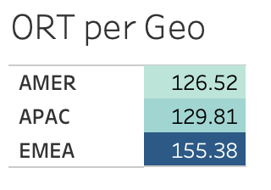
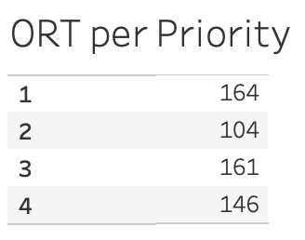
Analyze ORT
EMEA has the highest ORT of the three Geos – we may need to look at how many agents are staffed in EMEA to understand if we need more team members
Tickets with Priority 1 and 3 have the highest ORT
We should have the lowest ORT for Priority 1 tickets

Slide 14
improve
To improve the backlog we should first look at the contact forms to understand what information customers are providing us
If we can collect the required information from customers to begin with, we may be able to cut the amount of time it takes to resolve the tickets
The supporting systems also can be investigated, to understand if the steps required to assist customers can be improved upon
We can also implement automations that can help the customers by providing answers or resources to the topics that have the highest ORT or the highest volume

Slide 15
Control Charts
Subgroup Size is varied and above 20, so the S chart is used
We can see ORT is trending downward, but still relatively high
The downward trend could be because the team is outside of the training period, or because of the Pygmalion effect

